Slide 1
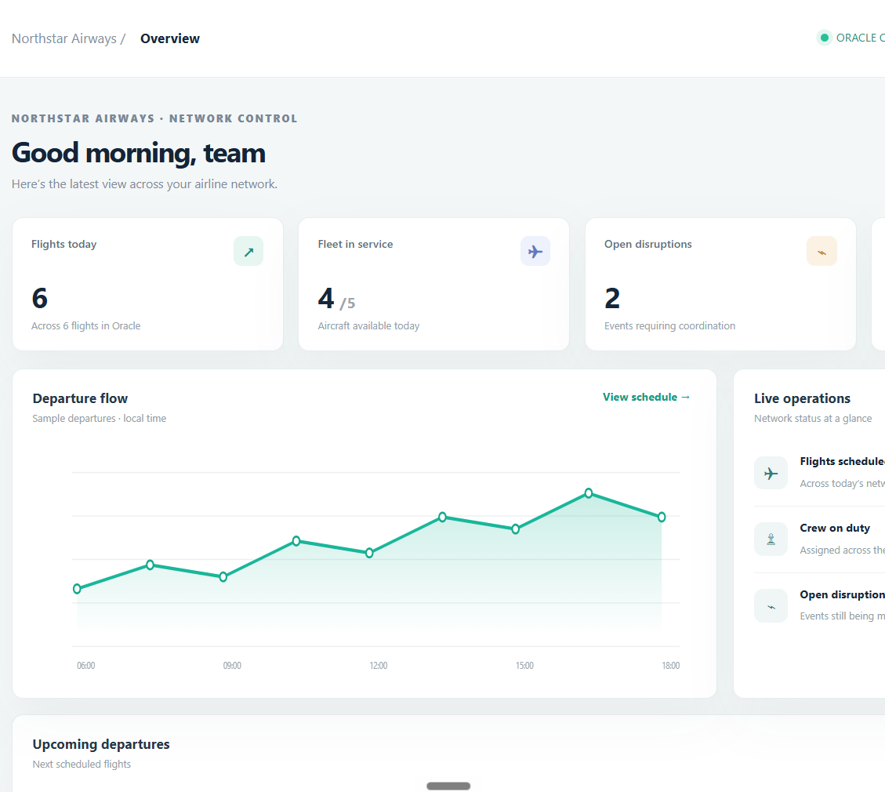
VIT • SCHOOL OF COMPUTER SCIENCE AND ENGINEERING
MODERN AIRLINE
LOGISTICS &
SUSTAINABILITY
MANAGEMENT SYSTEM
Database project
Pranali Paygonda Patil
25BCE2957 | B.Tech Computer Science and Engineering
School of Computer Science and Engineering • AY 2026–27
REVIEW PRESENTATION
Flights • fleet • crew • cargo • sustainability

Slide 2
NORTHSTAR / AIRLINE OPERATIONS
Project overview
Abstract
A relational database and browser console that connect airline operations records around the flight, making schedules, resources, cargo conditions, disruptions and emissions easier to review together.
WHY THIS PROJECT
One linked view
Better data quality
Sustainability visibility
Flights connect to aircraft, crew assignments, cargo, passengers, disruption events and fuel / CO₂ logs.
Primary and foreign keys, required values and checks help prevent broken links and invalid records.
Flight-level fuel and CO₂ fields create a starting point for operational comparison and reporting.
9
AIRCRAFT • FLIGHT • CREW • FLIGHT_CREW • PASSENGER • LOYALTY_TIER • SPEC_CARGO • DISRUPTION • EMISSIONS
relational entities
Current build: FastAPI + python-oracledb (Thin mode) + Oracle XE.
02

Slide 3
NORTHSTAR / AIRLINE OPERATIONS
How the system works
REQUEST PATH
Browser console
FastAPI service
Oracle driver
Oracle XE
›
›
›
HTML · CSS · JavaScript
Python routes + validation
python-oracledb • Thin
Tables + keys + checks
Sign in • browse • edit
JSON API • sessions
Bound SQL values
Committed records
DATA LIFECYCLE
1
Sign in
2
Read
3
Change
4
Refresh
Local account protects operational routes
Console requests records from Oracle
Create, update or delete through mapped API routes
Changes commit; views refresh from database
Operational data routes require sign-in; this coursework prototype runs locally at 127.0.0.1:8001.
03

Slide 4
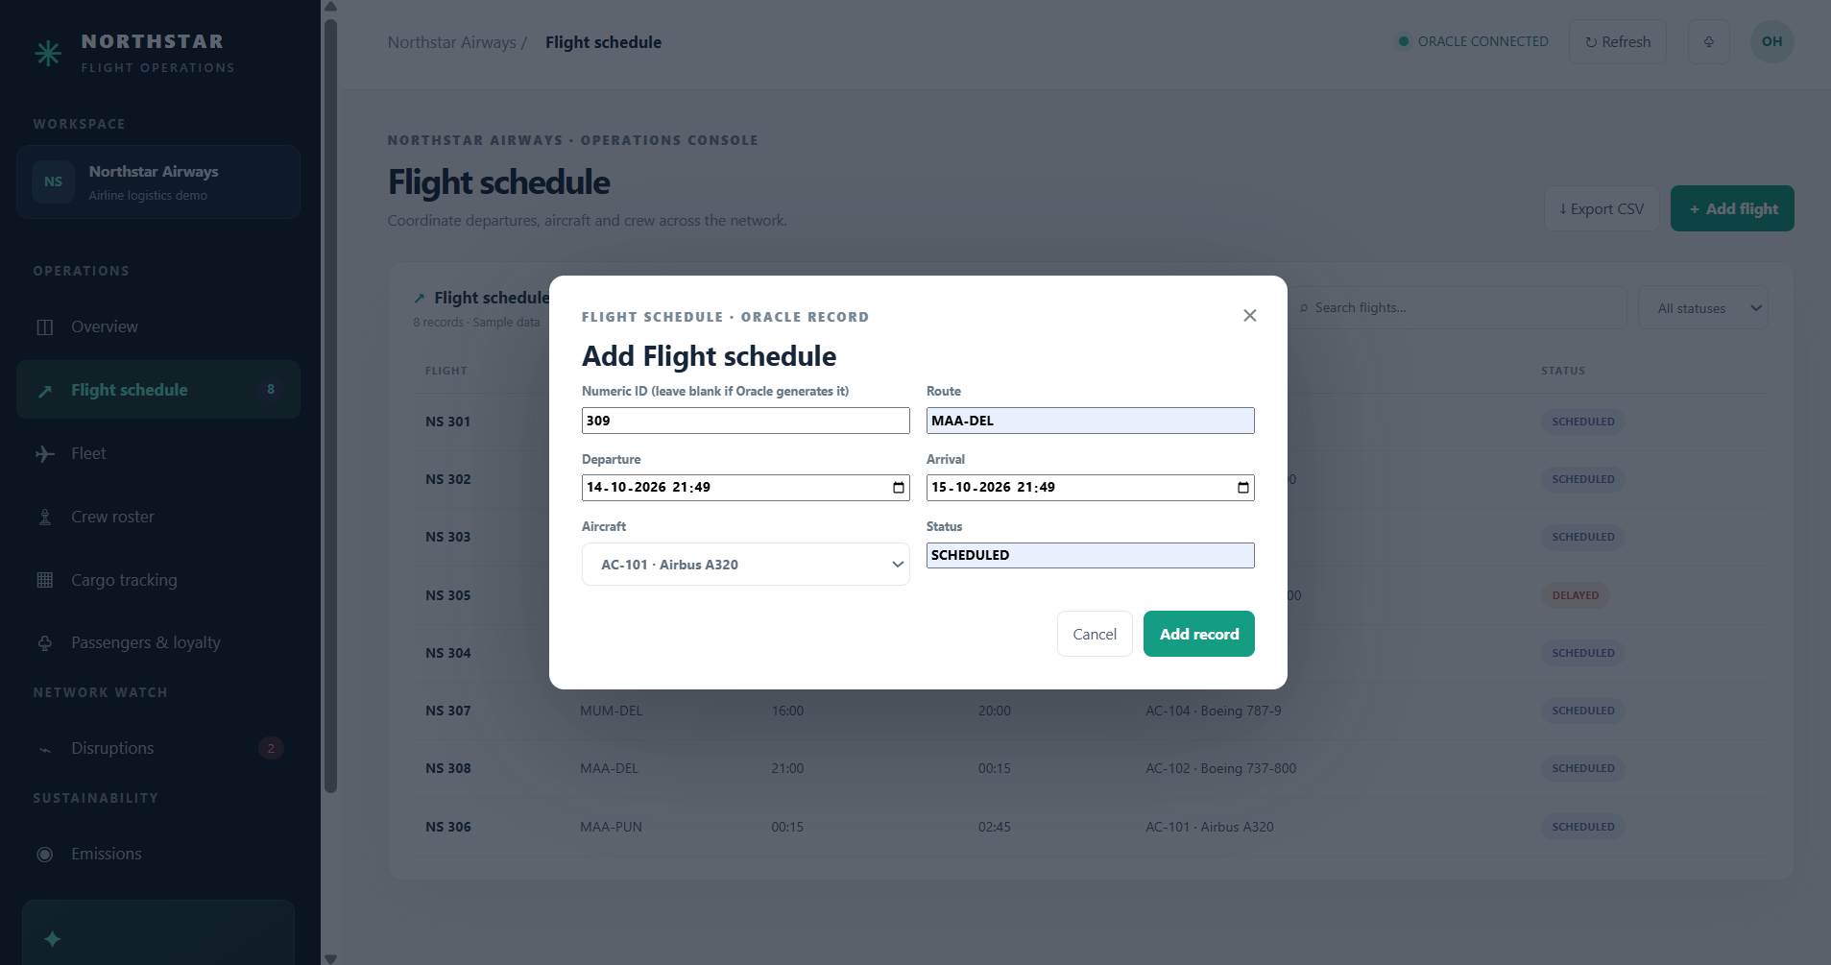
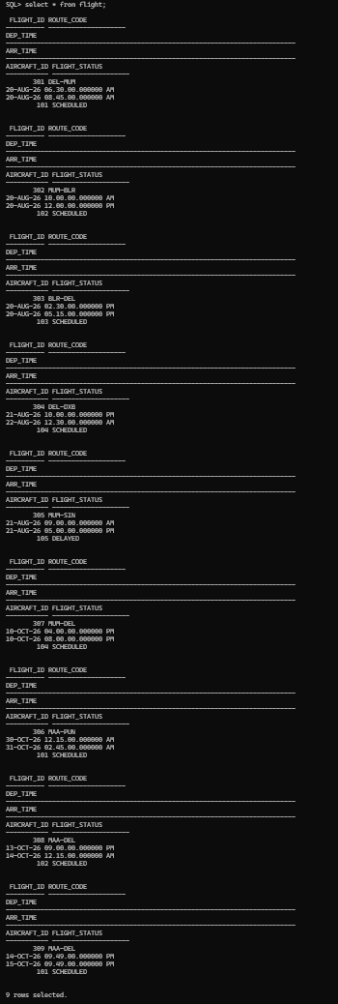
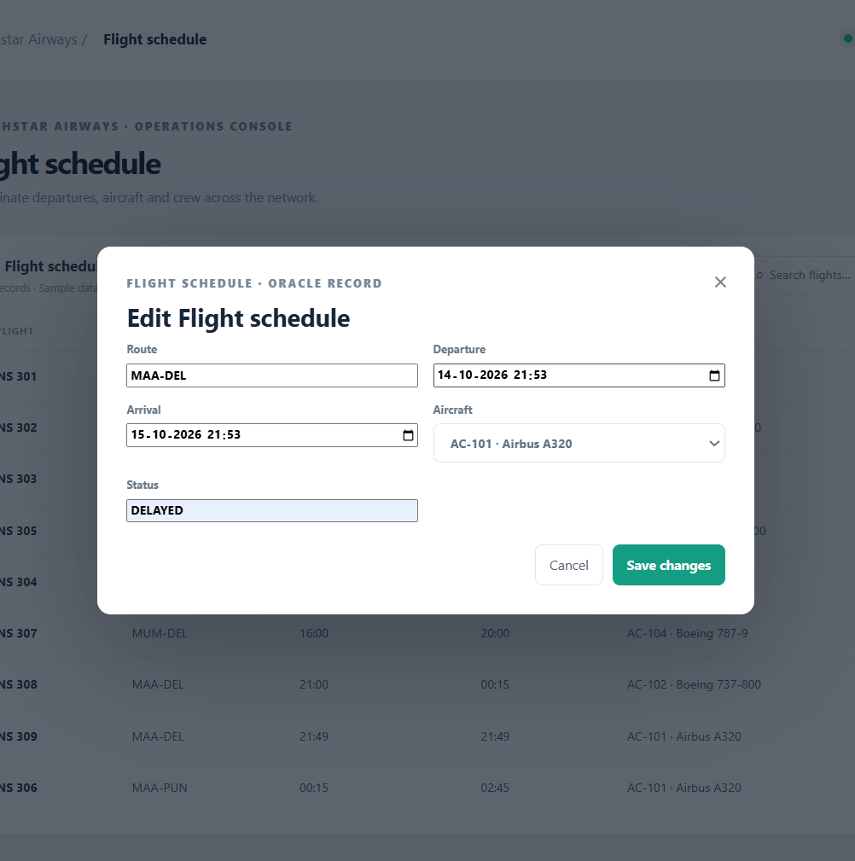
NORTHSTAR / AIRLINE OPERATIONS
Implementation and practical value
BUILT AND DEMONSTRATED
BUSINESS USE
Flight CRUD
Shared flight-linked records can reduce lookup across separate lists, help cargo teams spot temperature exceptions, and give analysts a base for route and fleet comparisons.
A flight was added and updated in Oracle. The delete screenshot shows the confirmation prompt, not the completed deletion.
Operations modules
Overview, flight schedule, fleet, crew, cargo, passengers, disruptions and emissions views.
Local implementation
FastAPI serves the browser console; python-oracledb connects the service to Oracle XE.
ADD RECORD
UPDATE RECORD
SUSTAINABILITY INSPIRATION
Make impact visible where operations are recorded: fuel and CO₂ per flight, plus temperature requirements and readings for sensitive cargo.
ORACLE ROWS
Potential value is a project hypothesis, not a measured financial or emissions outcome. Demo data is illustrative.
04

Slide 5
NORTHSTAR / AIRLINE OPERATIONS
Future implementation roadmap
The next steps move from a safer prototype to monitored operations and validated reporting.
NEAR TERM
OPERATIONS
SCALE + REPORT
Harden the prototype
Connect live workflows
Prove business outcomes
Role-based access and audit trail
Crew assignment with duty/rest checks
Validated emissions factors and boundaries
Stronger validation + explicit ID strategy
Cargo sensor feeds + threshold alerts
Route/load-normalized fuel reporting
Verify delete and access-control tests
Disruption history and response tracking
Approved airport and maintenance links
Backups, monitoring and error handling
Pilot with operations and cargo users
Cloud deployment and recovery plan
Before claiming impact, establish a baseline and validate data completeness, emission factors, fuel units and cargo temperature records.
05

Slide 6
NORTHSTAR / AIRLINE OPERATIONS
Project demo video
GOOGLE DRIVE LINK
https://drive.google.com/drive/folders/1iJCeO4C2KEm1-Avz9S9sdOv1OaXjlvBR?usp=sharing
SUGGESTED DEMO FLOW
1 Sign in
→
2 Open flight schedule
→
3 Add or update a flight
→
4 Show Oracle record
→
5 Visit cargo + emissions
The demo URL was not present in the supplied project files, so add it before submission.
06

Slide 7
✦
THANK YOU
MODERN AIRLINE LOGISTICS & SUSTAINABILITY MANAGEMENT SYSTEM
Pranali Paygonda Patil • 25BCE2957

